Slide 1
History Porifera
This group of animals is probably considered as the oldest animal group. They are also called as Sponges. These are the simplest multicellular animals, they do not have any tissues or organs. Sponges live in an aquatic habitat as they have to have an intimate contact with water. Water plays a major role in the feeding, exchange of gases and as well as excretion. The body of the sponges has many holes or pores called ostia. The body structure of sponges is designed in such a way that water moves through the body, where it can filter out food and also absorb the dissolved oxygen, along with eliminating waste material.
Organisms belonging to this phylum do not have specialized digestive, nervous or circulatory system. Instead, they have a water transport or canal system, which achieves the functions of digestion, excretion and also an exchange of gases.
Their bodies do not show any symmetry and their shape is adapted so as to allow maximum efficiency of water flow through the central cavity that is present inside. They generally feed on bacteria and other food particles that are present in the water. Their bodies have a large central cavity called the spongocoel. Water enters through the ostia into the spongocoel and goes out through the osculum. Cells called as Choanocytes or collar cells line up the spongocoel and canals, with their flagellum protruding out. It is the beating of this flagellum from all choanocytes that moves the water all through the body of the sponge.

Slide 2
Characteristic Features of Phylum Porifera
They are generally marine aquatic organisms, with a few freshwater species.
Their bodies are asymmetrical.
Body shape can be cylindrical, vase-like, rounded or sac-like.
They are diploblastic animals with two layers, the outer dermal layer and the inner gastral layer. There is a gelatinous, non-cellular mesoglea, in between these two layers. This contains many free amoeboid cells.
The body has many pores called the ostia and a single large opening called osculum at the top.
Spongocoel is the body cavity that is present.
They have the characteristic canal system for the flow of water through the body.
Sense organs are absent.
There is an endoskeleton present with calcareous spicules (calcium carbonate) or siliceous spicules (silica) or sponging fibres (protein).
Sexes are not separate.
Asexual reproduction is seen through budding, fragmentation. Sexual reproduction is seen in certain species, through gametic fusion.
Examples:
Sycon (Scypha)
Spongilla (Freshwater sponge)
Euspongia (Bath sponge)

Slide 3
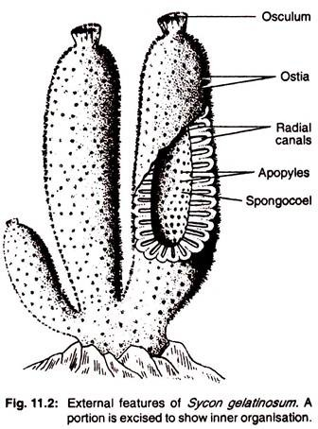
Sycon (Scypha)
Habit and Habitat :
Sycon is a marine sponge and remains attached to solid substrata like rocks, shells of molluscs and corals. The name of genus, Sycon, is replaced by Scypha by de Laubenfels (1936). But in our present discussion the name Sycon is retained. The different species of sponges under the genus do not tend to live at greater depths in the ocean.
Structure : The sponges exhibit a great diversity in form. They range from a very simple to more complicated forms. Sycon occupies an inter­mediate status from the point of structural diversities. It has the form of branched cylin­ders of about 2.5 to 7.6 cm. in length. All the branches are connected together at the base which remains attached to the sub-stratum.
Though the body has a firm consistency, it is slightly flexible. Close examination of the surface reveals the presence of innumerable minute inhalent pores or ostia. The free end of each cylindrical branch possesses an open­ing at the summit. This opening is known as osculum

Slide 5
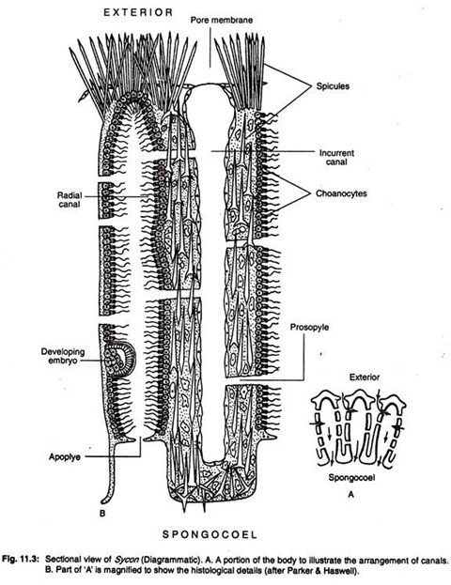
Canal System of Sycon
Paragastric cavity or gastral cavity or spongocoel:
Sycon is observed that the outer large opening, called osculum, leads into a large central canal. This canal is called paragastric cavity or gastral cavity or spongocoel.
Although this cavity is variously named, the name of spongocoel
seems to be more appropriate. The wall of the Sycon is lined by ectodermal flattened cells, called pinacocytes. The osculum is surrounded by a layer of cells, called myocytes which are contractile in nature and act as sphincter. The spongocoel opens to the exterior through the osculum.

Slide 6
Radial canals:
The body wall lining of the spongocoel is out-pushed at regular intervals as finger-like projections. These projections are called radial canals. The wall of the radial canal is lined with flagellated collar cells or choanocytes. The outer end of the radial canal is blind but the inner end is open which communicates with the spongocoel through the excurrent canal.
Incurrent canal: In between two successive radial canals, a tubular space, called incurrent canal or inhalent canal, is present, thus radial canals and incurrent canals are arranged alternately and the latter opens to the exterior through ostia. The in­ner end of the incurrent canal is blind. The wall of the incurrent canal is lined by ecto­dermal, flat pinacocytes.
Between the incurrent canal and radial canal there is a thickened mesogloea, called gastral cortex. The ostia are situated on the pore membrane which are intercellular openings and are surrounded by contractile myocytes. These myocytes act as sphincters, by which they regulate the diameter of the openings.

Slide 7
Prosopyles:
The wall between the incurrent and radial canals is pierced by numerous minute pores called prosopyles. In Sycon, each prosopyle is an intercellular space or channel while in Leucosolenia these pores are intracellular. Through these pores, the incurrent canals open into the radial canals.
The prosopyles are the openings of the porocytes, generally believed to be modified pinacocytes. The porocytes are thick-walled cylinder-like structure with a nucleus in the cytoplasm at one side. It is highly contractile and controls the inflow of water.
Ex-current canals:
The radial canals communicate into the spongocoel through short, wide canals, called excurrent canals. The wall of the excurrent canal is lined by flat, pinacocytes.
Apopyles:
The excurrent canals open into spongocoel by internal ostia or apopyles. The apopyles are surrounded by contractile myocytes.

Slide 8
Physiology of Water Current Production in Sycon:
The circulation of water in Sycon takes place in the following way. The course of water current has been studied by the application of fine carmine particles to the surface of the body. The water rushes inside the body through numerous ostia along the external surface.
Each ostium or dermal pore leads into an incurrent canal. From the incurrent canal, the water flows inside the radial canal through prosopyle. From radial canal water passes out through apopyles into the spongocoel. The spongocoel is thus a common chamber within which all the radial canals of the body open.
The spongocoel ultimately opens to the exterior through an aperture, the osculum. Water enters inside the body through numerous doors (ostia) but passes out through a single opening (oscu­lum). The planar beating of the flagella of choanocytes in the radial canals produces a current which in one hand draws the water inside and on the other hand forces it to go out.

Slide 10
Microscopic Organization of Sycon:
The microscopic organisation shows the presence of a single layer of cells covering the outer surface of the body. This outer layer is designated as the dermal layer. Needle­like spicules are seen to project from this layer. This layer is composed of large cells called the pinacocytes.
The spongocoel is lined by a layer of flattened endodermal cells, Radial canals are lined by peculiar collar cells, each having a long whip-like flagellum. These cells are called the choanocytes or collar cells or gastral cells

Slide 11
Each choanocyte has a round or oval body. It possesses a nucleus and one or many vacuoles in its cytoplasm. The free end of the cell body has a compara­tively longer flagellum and the base of the flagellum is surrounded by a contractile trans­parent collar-like outgrowth of the cytoplasm.
The flagellum arises from the basal granule which is connected with the blepharoplast by a root called rhizoplast. Electron micro­scopic studies have revealed that the collar­-like outgrowth is composed of cytoplasmic tentacles. The number of such tentacles var­ies from 20 to 30. The sectional view of flagellum under E. M. reveals the pattern of 9 + 2 arrangement of microtubules, like the flagella of flagellates.
The spicules, which constitute the ske­leton of Sycon, develop from the scleroblasts. These structures are regularly arranged and protect the softer parts. Triradiate as well as tetraradiate spicules are common. Besides these, simple club-like oxeote spicules are also present.
The intermediate layer, called mesohyl or mesenchyme, which consists of a gelatinous proteinaceous matrix, contains spicules and numerous amoeboid cells.

Slide 12
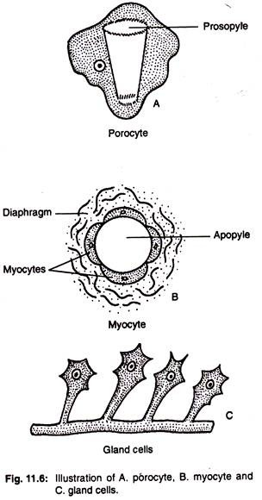
The amoeboids are of many types and are as follows:
Archaeocytes: They are undifferenti­ated embryonic amoebocytes
which are large in size and their nuclei show distinct nucleoli
They are totipotent in nature and can transform into different
kinds of cells, needed by the animal. They play a role of
digestion,eliminating waste material and can give rise to both
sperms and ova.
Collenocytes: Most of the other cells are smaller and stellate
Shaped and possess radiating processes. These cells are usually
called collenocytes or connective tissue cells. They remain fixed
by cytoplasmic processes.
Chromocytes: These are pigmented amoebocytes with lobose
pseudopodia.
Thesocytes: These amoebocytes are storage cells with lobose
pseudopodia.
Myocytes: These are fusiform and highly contractile cells,found
around the osculum, apopyles and other pores. These cells are
arranged in circular fashion and act as a sphincter and regulat
the diameter of the openings. So water flow through oscu­lum is
regulated .
Gland cells: These cells are found attached to the body surface
by long strands and -secret lime The osculum, prosopyles and
apopyles have
elongated narrow cells which prolong into narrow fibres around
the aforesaid ap­ertures and help them to close, when neces­sary.

Slide 13
6. Nutrition, Respiration and Excretion in Sycon:
The sponges feed on micro-organisms which enter into the body along with the water current. The choanocytes engulf them and pass them to the amoeboid cells situated below the choanocytes. The digestion takes place inside the amoeboid cells and assimi­lated products are conveyed to the various parts of the body.
Thus nutrition is holozoic and digestion is intracellular, a process com­parable to that of protozoans. Some amoe­boid cells often contain chlorophyll or green pigments and carry out autotrophic nutri­tion like green plants.
The presence of algae within the sponge body also helps in nutri­tion. Respiration and excretion take place by diffusion. The contractile vacuoles are re­corded in the amoeboid cells of freshwater sponges which probably play important role in osmo-regulation and excretion.

Slide 14
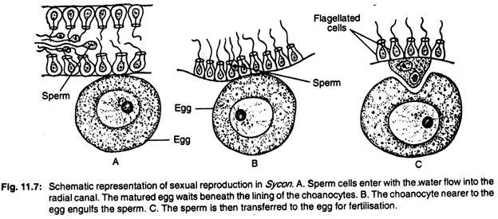
Reproduction in Sycon:
Sycon reproduces both asexually and sexually. During asexual reproduction it produces bud and sometime
produces special bodies resembling the gemmules of freshwater sponges. During sexual reproduction, both
sperms and ova are produced from the archaeocytes which are present in the mesoglea. It is claimed that
the sex cells are also produced from adult choanocytes. The sperm cells have long tails and swim freely in
water current. The ova are amoeboid and wander through the mesoglea.
The ova may grow up in size by ingesting other cells. The sperm cell does not enter the ovum directly. The
union is assisted by a choanocyte. When sperm cells enter the radial canal, the choanocyte which is nearer
to the egg captures it. The choanocyte which absorbs the sperm discards its flagellum and collar and comes
very near the egg. This choanocyte is named as the carrier cell. The sperm subsequently loses its tail and
enters the egg. The carrier cell is ultimately absorbed. The early development takes place within the body of
the mother sponge. When the development is complete, the larva forces its way into the radial canal and
finally to the exterior.

Slide 15
Development of Sycon:
The fertilized egg or zygote divides re­peatedly to form a round mass of cells (Fig. 11.8). It is mostly covered with homogeneous cells but at one end a few thickly granulated cells appear.
The homogeneous cells grow flagella and completely enclose the granu­lated cells. Soon the cells at one half lose their flagella and become large and granular. The hollow and swimming larva at this stage is called amphiblastula stage and the larva in this stage leaves the parent body.
Gradually, the flagellated cells invaginate and finally the granular cells completely enclose the flagellated cells. The flagellated cells form the choanocyte lining while the granular cells give rise to the dermal epithelium. The larva fixes itself to a substratum and an aperture, called osculum, appears at the free end.
Fur­ther growth results into the thickening of the wall within which flagellate cells traverse and thus leads to the formation of radial canals. Numerous pores appear on the sides to form inhalent apertures.

